Slide 1

Commander 2 & 3 VFD’

Slide 2
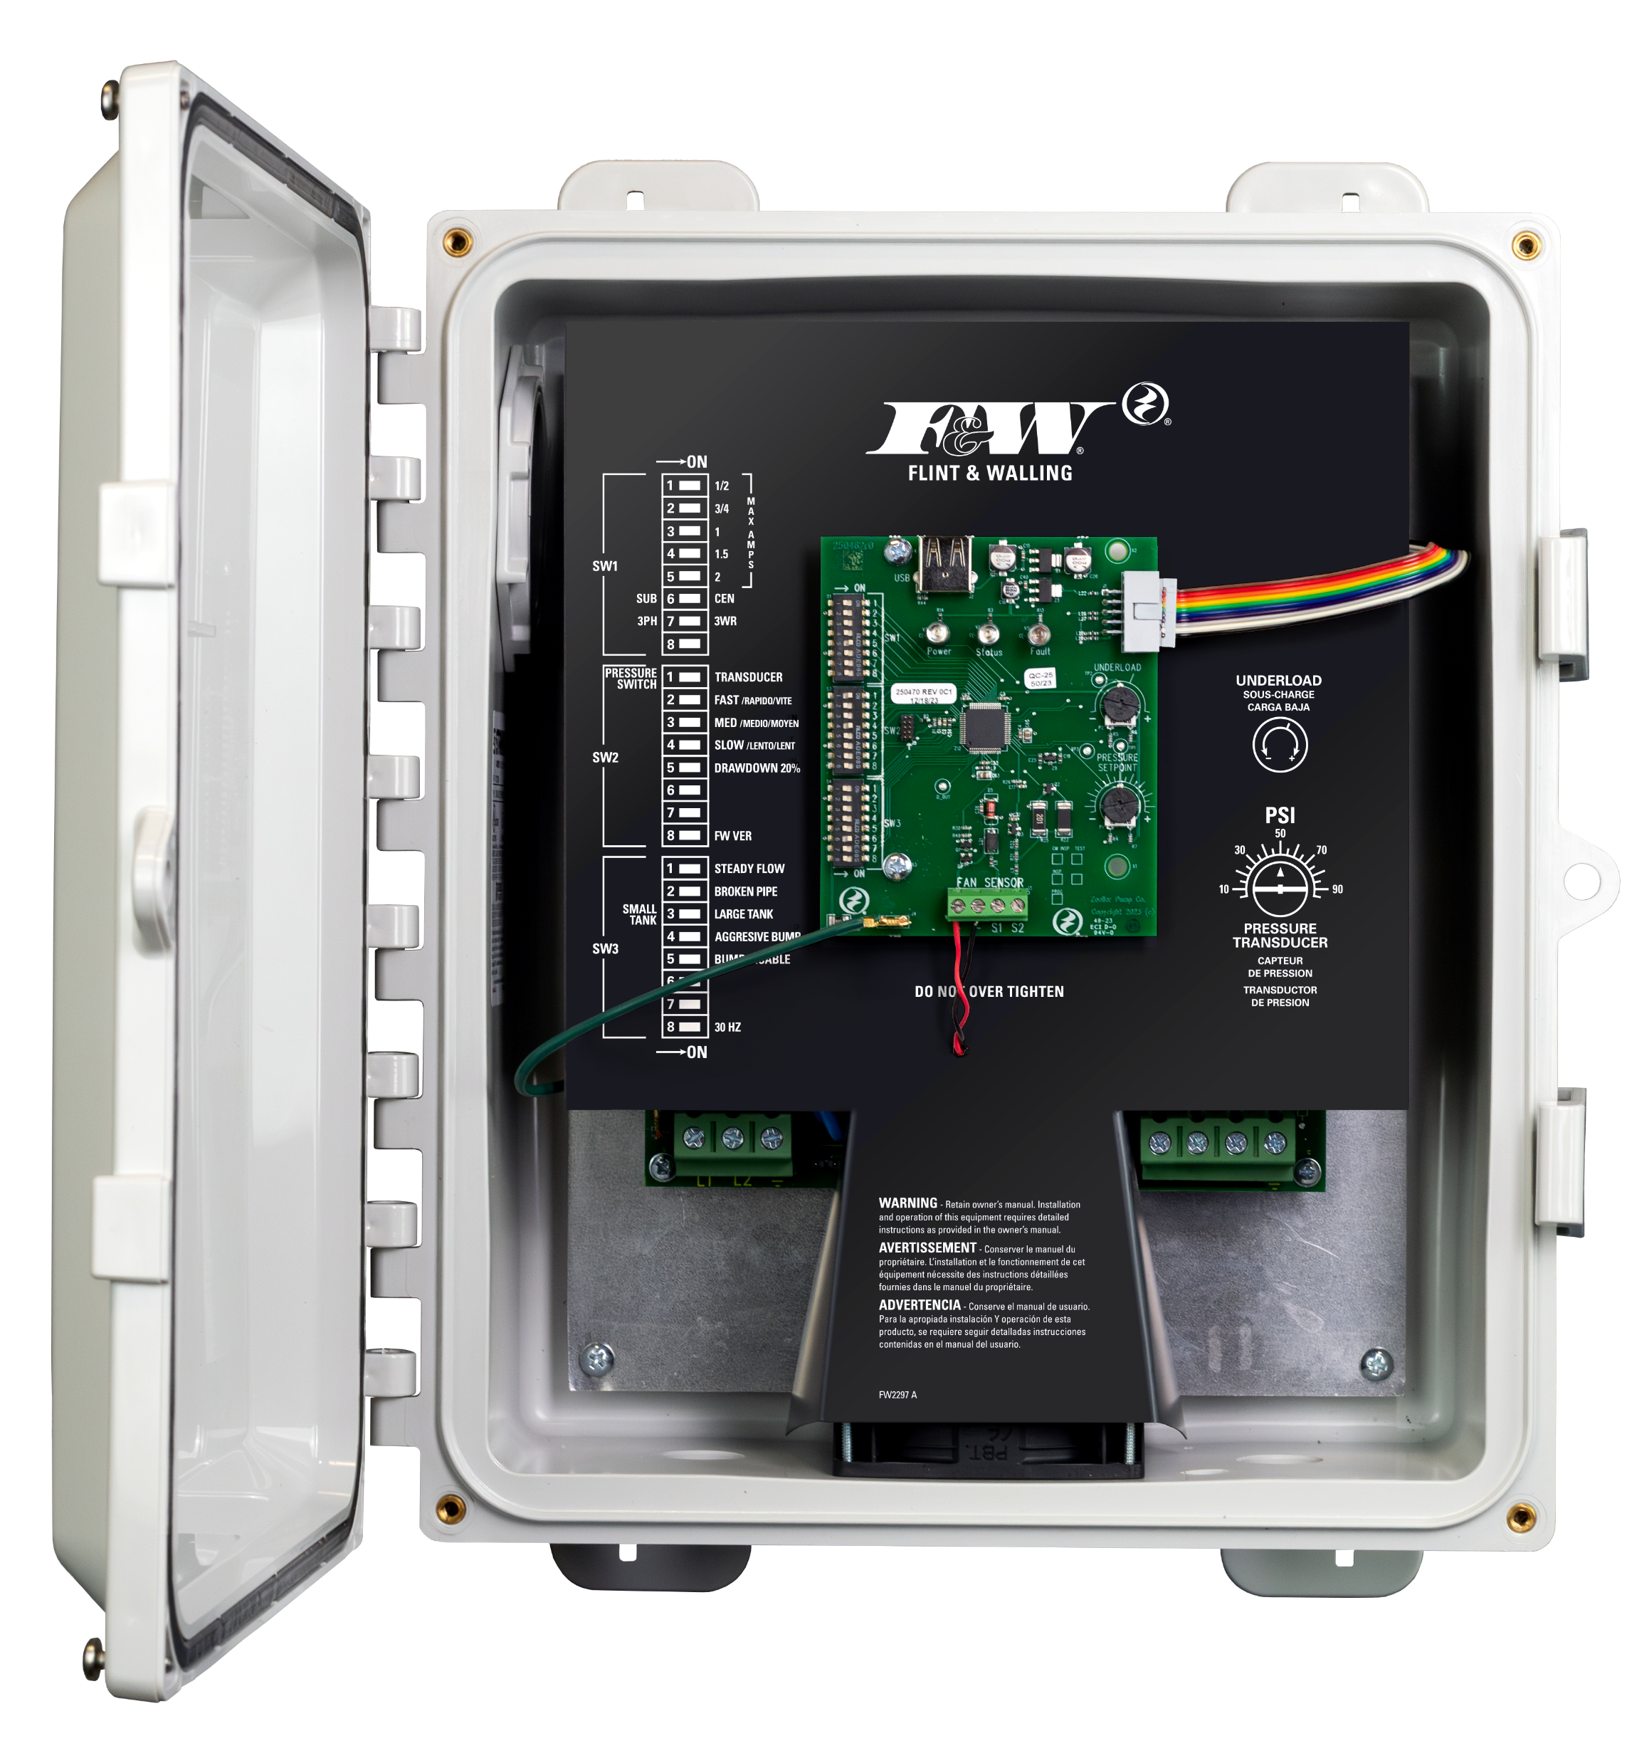
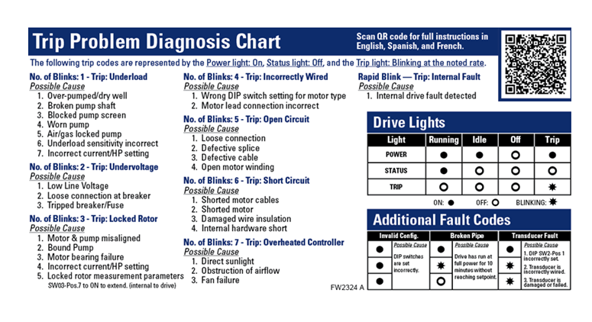

Slide 3
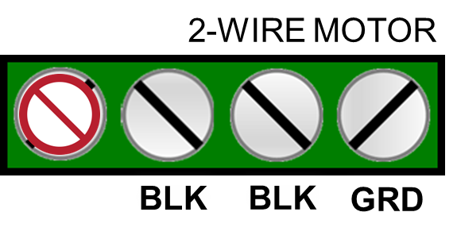
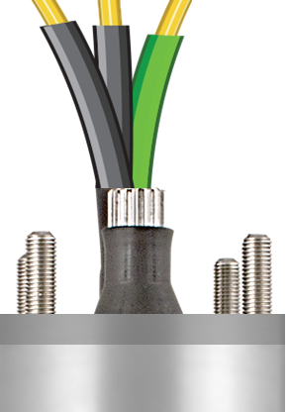
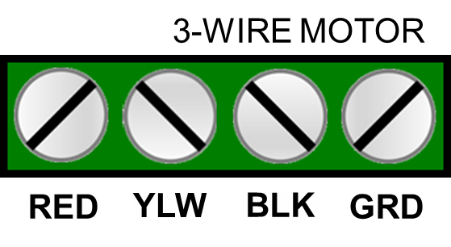
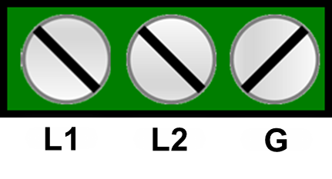
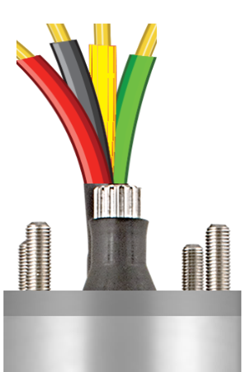
COMMANDER 2 & 3
Input power
To motor

Slide 4
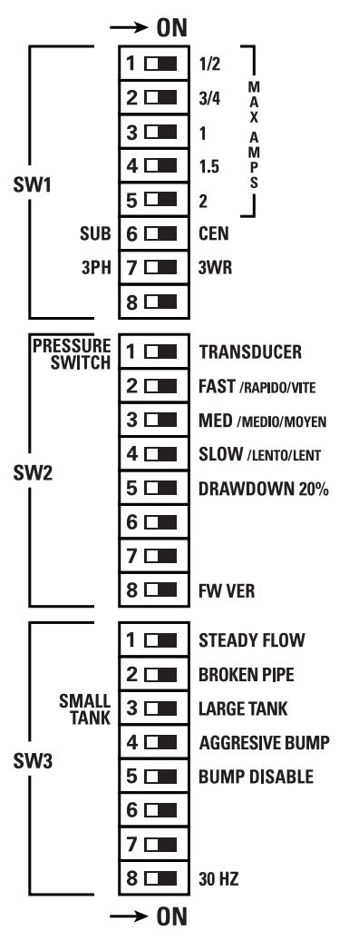
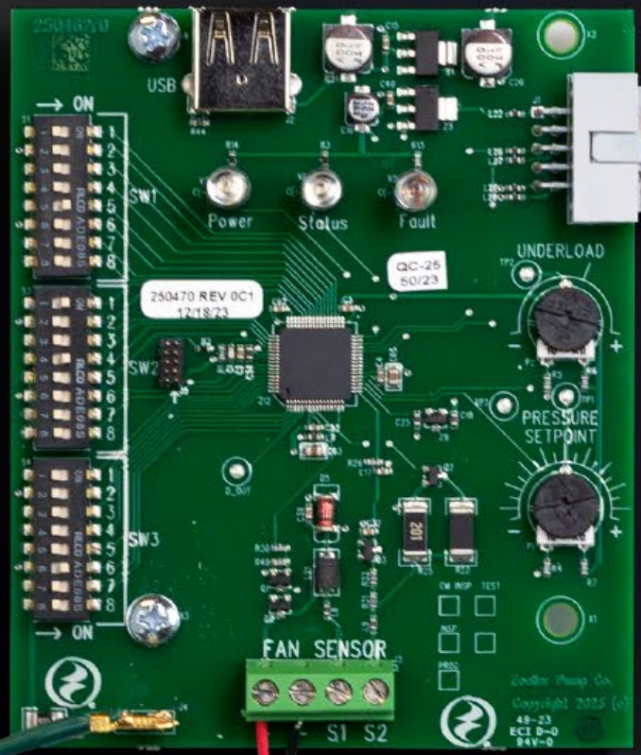
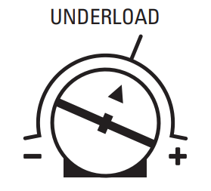


Slide 6
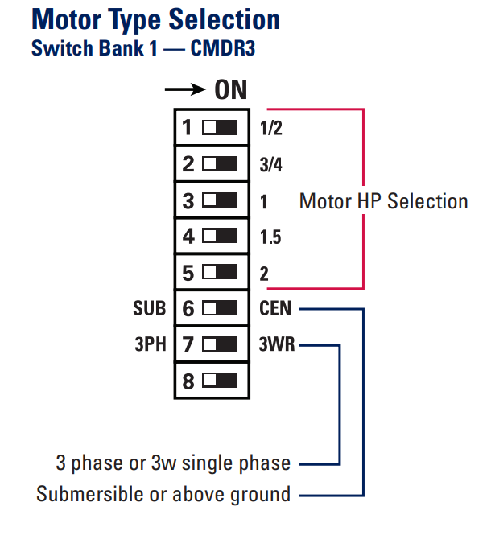
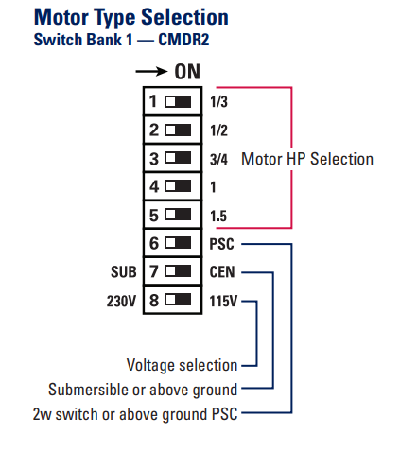
COMMANDER 3
COMMANDER 2

Slide 7
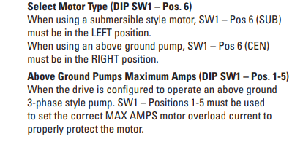
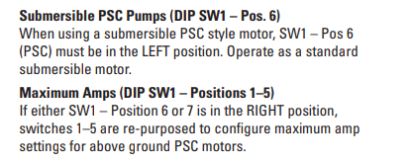
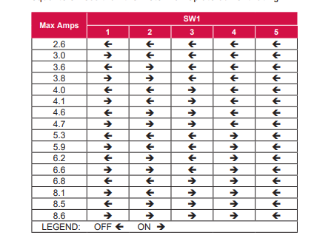
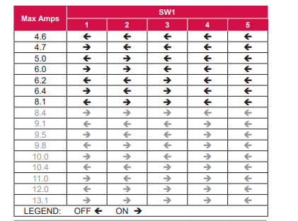
COMMANDER 3
COMMANDER 2

Slide 9
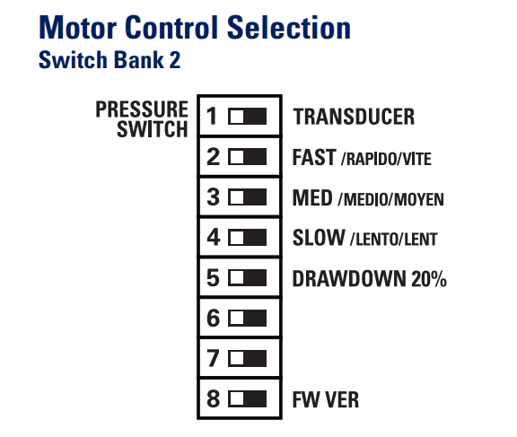
COMMANDER 3 / COMMANDER 2

Slide 10

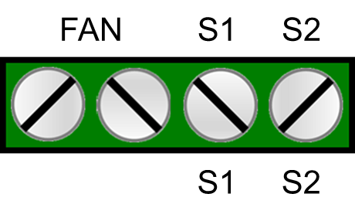

Connect Brown wire to terminal S1 and Blue wire to terminal S2
Connect Red and Black lead wires to terminals S1 & S2 (interchangeable)
Transducer
Switch
● Model Nos.
CMDR2-T (transducer)
CMDR2-S (switch)
CMDR3-T (transducer
CMDR3-S (switch)

Slide 12
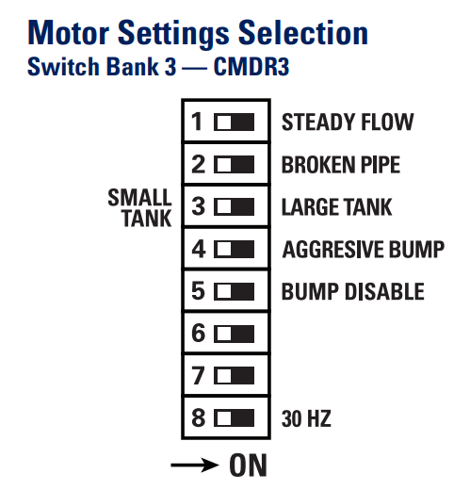
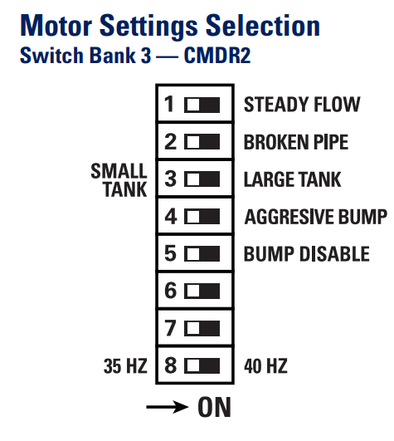

COMMANDER 3
COMMANDER 2
*
*

Slide 14
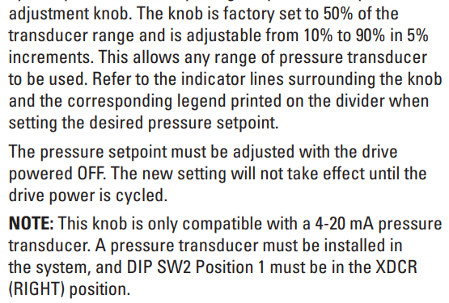
1
2
3

Slide 16
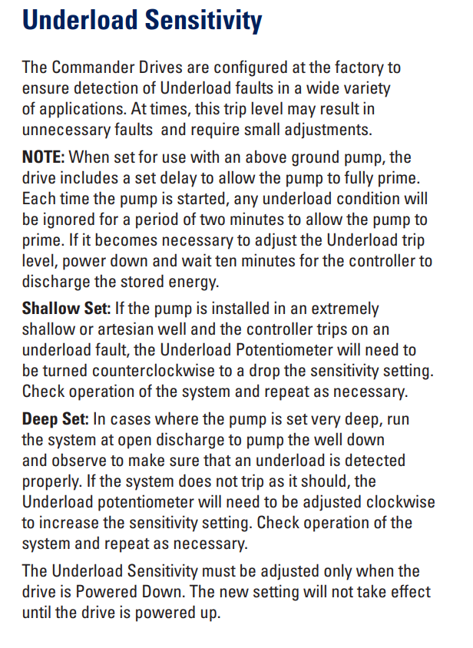

Slide 17


VFD SYSTEM TROUBLESHOOTING

Slide 18
subscribe
https://www.youtube.com/@flintandwalling

